Slide 1
Capstone
Project - Recommendation System
Group 3 - WONG, Shing Fung (Dov)

Slide 2
Table of Contents
01
02
03
04
05
06
Dataset Introduction
Data Preprocessing
EDA
Recommendation System
Exploratory Data Analysis
Content based, Collaborative
Challenges and Limitations
Future Work

Slide 3
01
Dataset Introduction

Slide 4
Dataset Introduction
Kaggle - Retailrocket recommender system dataset
events.csv
category_tree.csv
item_properties_part1.csv
Item_properties_part2.csv

Slide 5
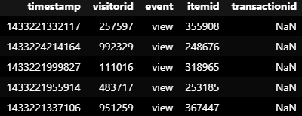
Dataset Introduction - event
timestamp - Unix Timestamp ← Will convert later
visitorid
event
view
addtocart
transaction
itemid
Transactionid
Only exist when ‘event’ = ‘transaction’

Slide 6
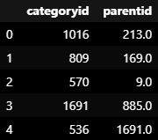
Dataset Introduction - category_tree
categoryid
parentid
Not all category have parent

Slide 7
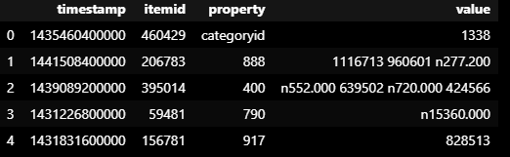
Dataset Introduction - item_properties
timestamp
itemid
property - Time based, 3 types
“categoryid” -> “value” will show categoryid
“available” -> “value” will show 1 (available) or 0 (unavailable)
Numeric value -> property (unknown meaning)
value - hashed data (unknown meaning)
String -> integer
Numeric value -> add “n” at the beginning and have 3 digits precision after decimal point.

Slide 8
02
Data Preprocessing

Slide 9
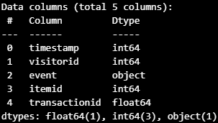
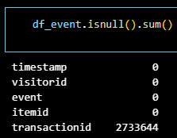
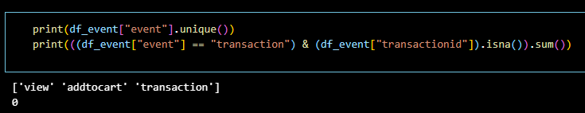
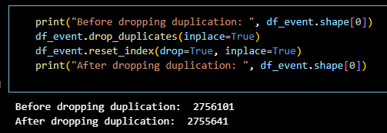
Data Preprocessing
Info
Check missing value
Drop duplication
No missing transactionid

Slide 10
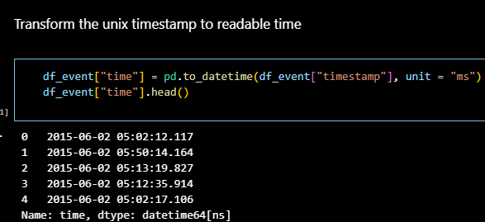
Data Preprocessing(con’t)
Transform the unix timestamp to readable time

Slide 11
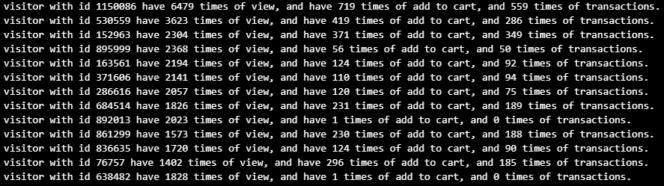
Data Preprocessing(con’t)
Try to identify abnormal users, windows shoppers and outliers

Slide 12
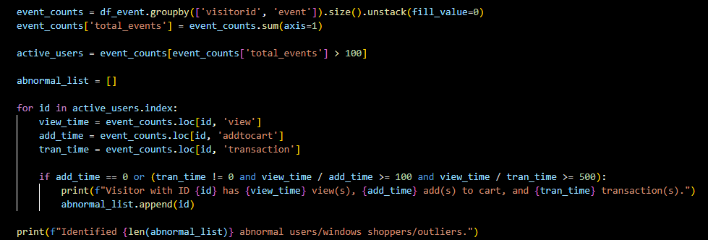
Data Preprocessing(con’t)

Slide 13
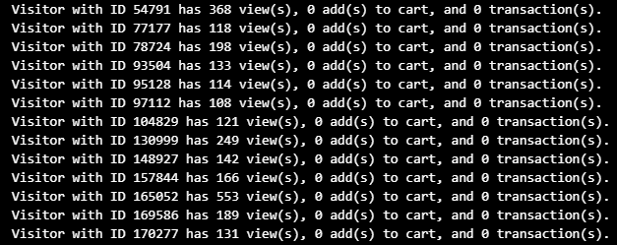
Data Preprocessing(con’t)
Some results
Drop the visitorid found

Slide 14
03
EDA (Exploratory Data Analysis)

Slide 15
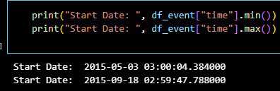
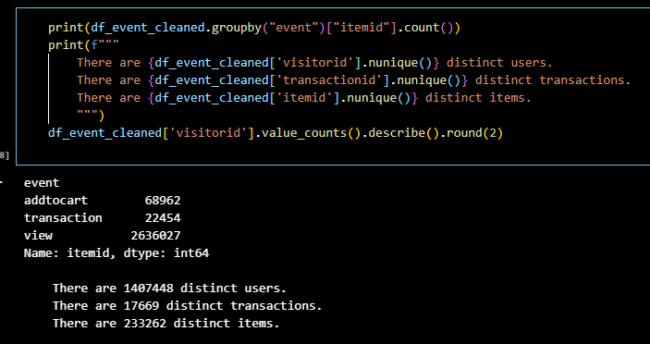
EDA
Time period of dataset:
2015-05-03 03:00 to 2015-09-18 02:59
2636027
View
Add to cart
Transaction
68962
From view: (2.62%)
22454
From view: (0.85%)
From cart: (32.56%)

Slide 16
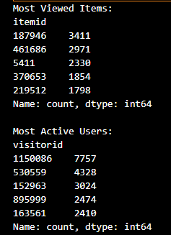
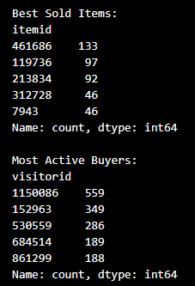
EDA

Slide 17
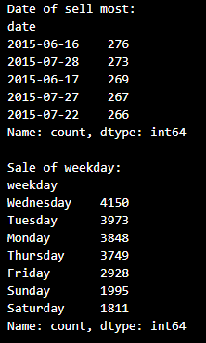
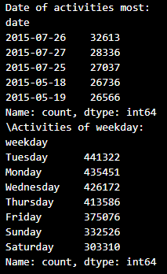
EDA

Slide 18
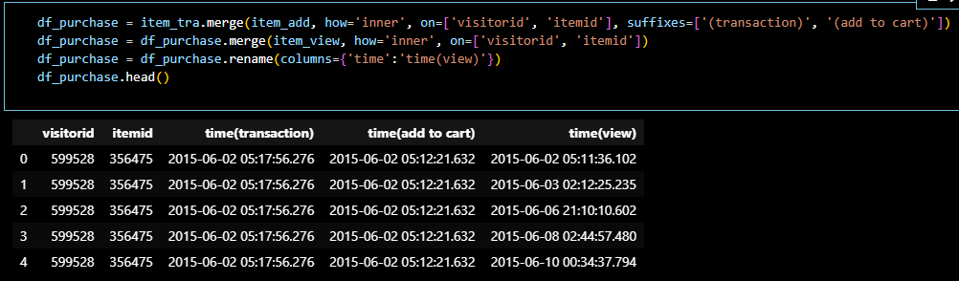
EDA - Average view before purchase
Breakdown the “event” into three separate data frame (view, addtocart, transaction)
Inner join these 3 data frame -> each transacted item will have time for transaction, add to cart, and view.

Slide 19
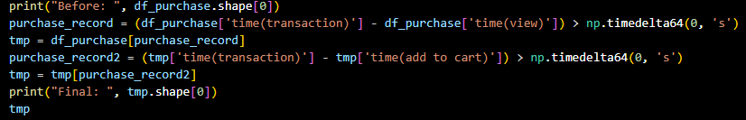

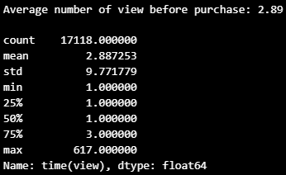

EDA - Average view before purchase
Keep the row only time for transaction > add to cart > view
Groupby ‘visitorid’ and ‘itemid’ and get the information about it

Slide 20
EDA - Average view before purchase
Keep the row only time for transaction > add to cart > view
Groupby ‘visitorid’ and ‘itemid’ and get the information about it

Slide 21
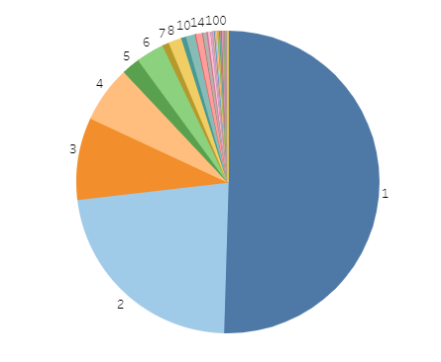
EDA - Average view before purchase
Tableau: https://public.tableau.com/app/profile/shing.fung.wong/viz/CapstonePRoject/Distribution?publish=yes

Slide 22
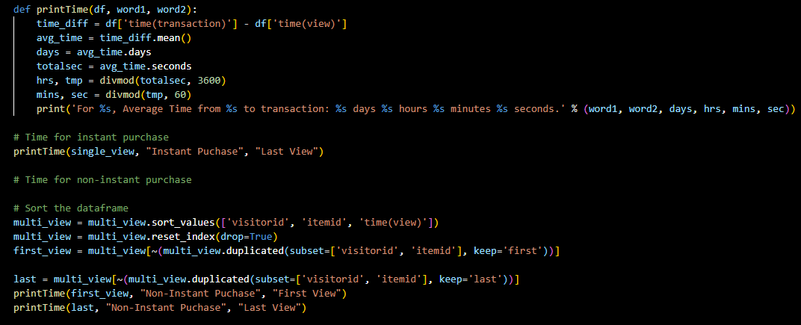
EDA - Average time before purchase

Slide 23
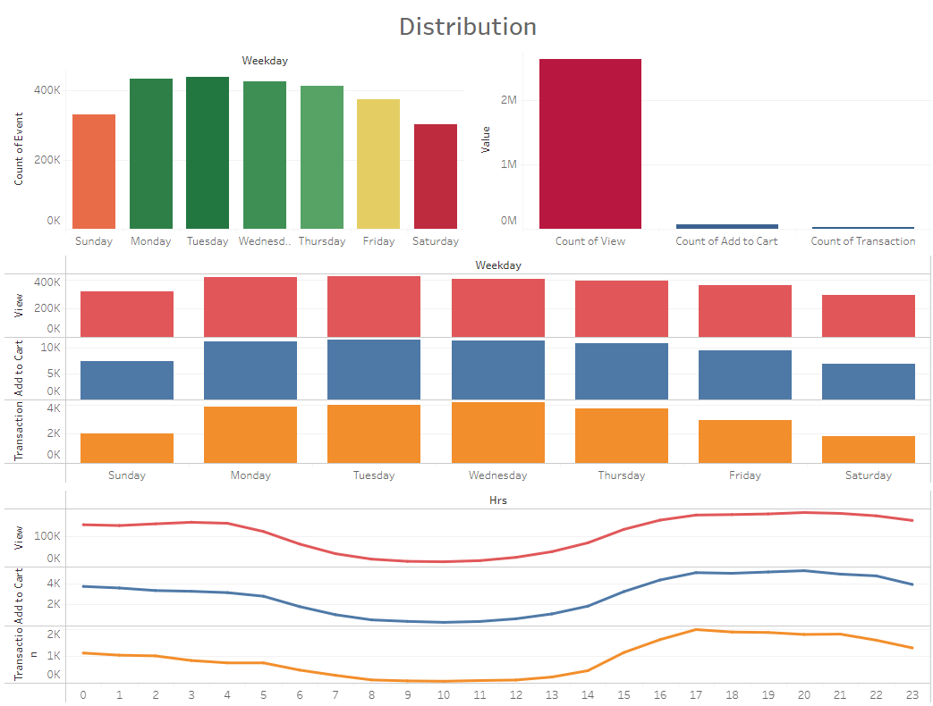
EDA - Distribution of event

Slide 24
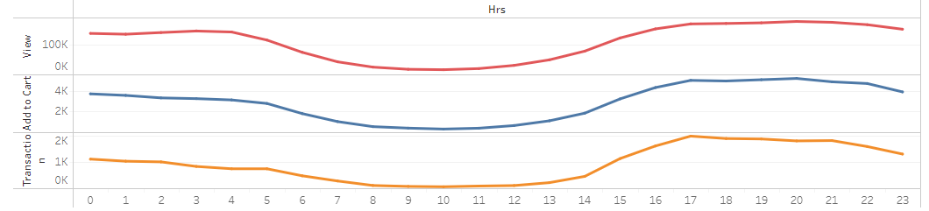

EDA - Distribution of event (con’t)
After lunch, people tend to not to work, but start to shop?

Slide 25
04
Recommendation System

Slide 26
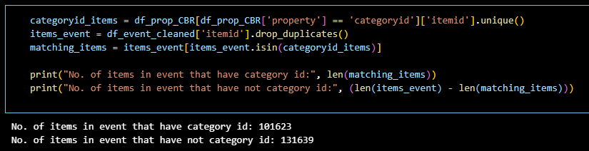
Recommendation - Content Based
Data Preprocessing
Drop the rows if “property” = “available”
Drop “timestamp”
Drop duplication
Drop the rows if “property” = “categoryid”
Reason: About 50% of items have not this row

Slide 27
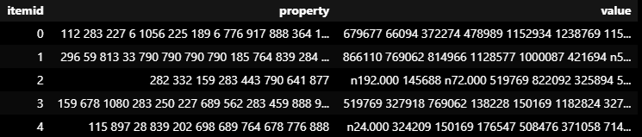

Recommendation - Content Based
Feature Engineering
Groupby “itemid” and aggregate property and value
Check null

Slide 28

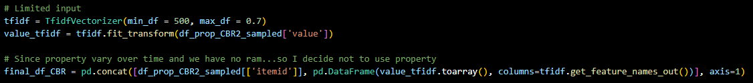
Recommendation - Content Based
Limitation of computing resources…
Sampling (1/10)
Set limitation when vectorize
Use “value” only
Vectorize -> Convert text to number

Slide 29
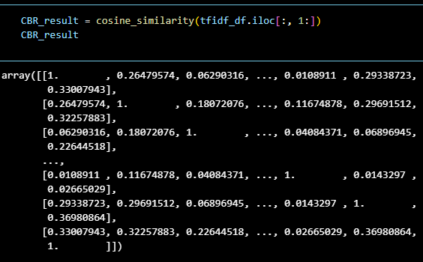
Recommendation - Content Based
Implement Cosine Similarity Algorithm -> Find similarity based on “value”

Slide 30

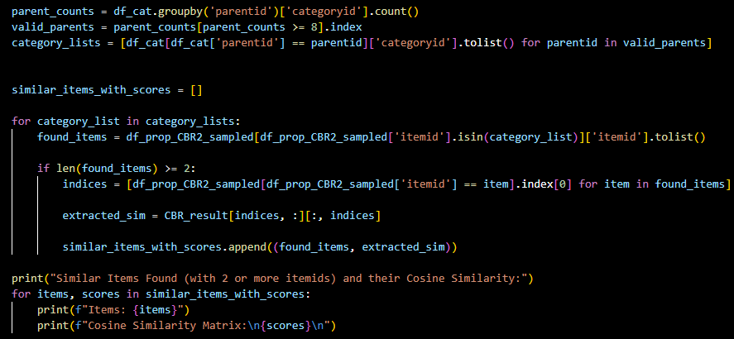
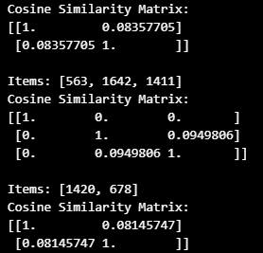
Recommendation - Content Based
Try to validate the result (Highly similar if the value is closer to 1)
Find the categoryid under same parentid
Compare their similarity (Suppose they are similar under same parent…)
FAIL!

Slide 31
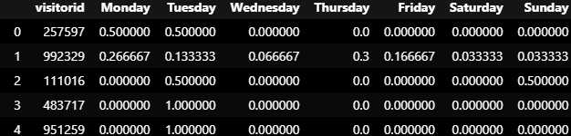
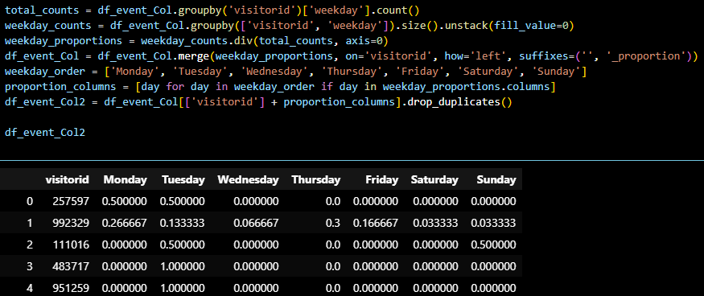
Recommendation - Collaborative Filtering
Data Preprocessing (Use weekday as the only feature)
Drop all unnecessary columns
Feature Engineering
Break up into 8 columns (Monday to Sunday & Activity Count)
Convert count into proportion

Slide 32
Recommendation - Collaborative Filtering
Limitation of computing resources again…
Sampling (1/100)
Implement MinMaxScaler to convert “Activity Count” into value from 0 to 1
Implement Cosine Similarity Algorithm

Slide 33
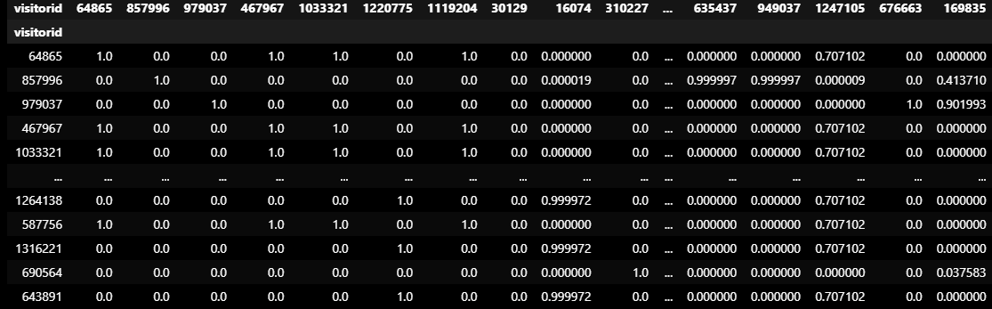
Result - Collaborative Filtering(a)
Use Mon - Sun & Activity Count
Too many 0 → Seems not good

Slide 34
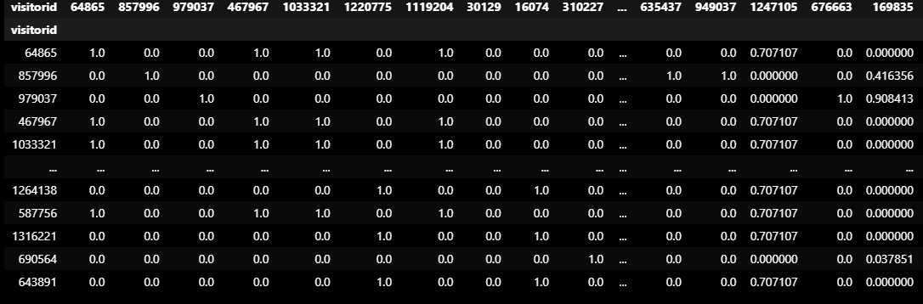
Result - Collaborative Filtering(b)
Use Mon - Sun only
Seems similar…

Slide 35
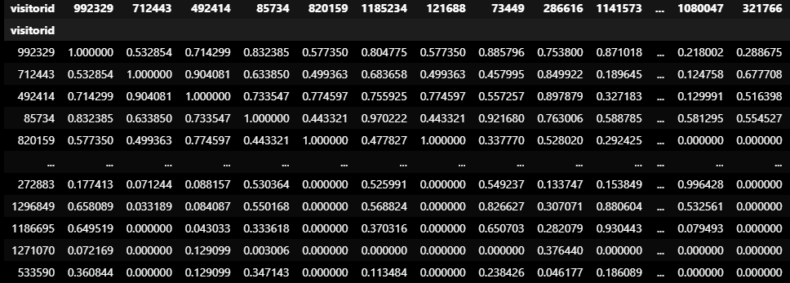
Result - Collaborative Filtering(c)
Drop users with activity count < 30 & use Mon - Sun only
Look good!!!

Slide 36
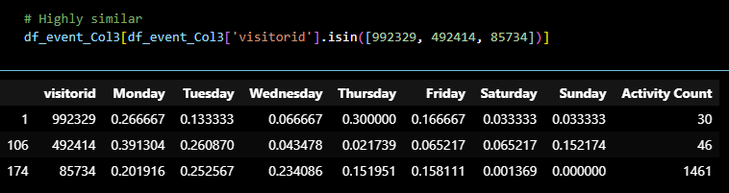
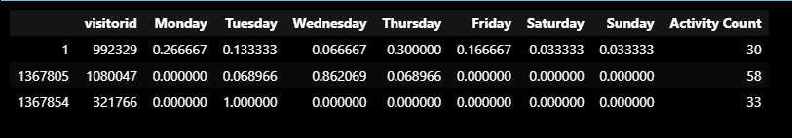
Validation- Collaborative Filtering(c)
Not sure is it similar….
Let Compare with low similarity

Slide 37
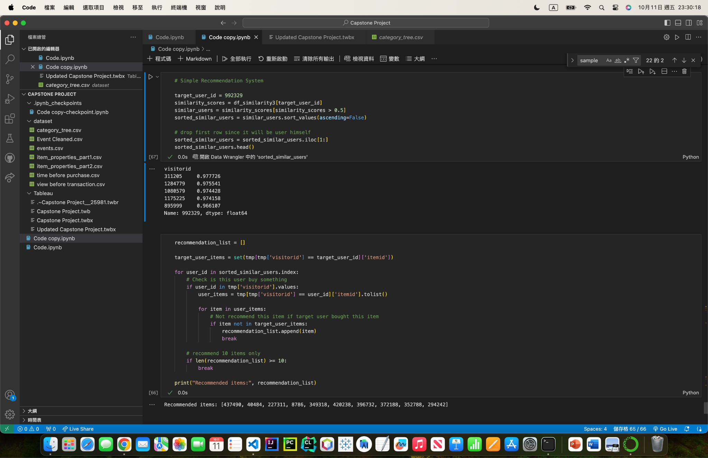
Simple Implementation of Recommendation System
Retrieve the list of visitorid with descending similarity
Recommend item based on the similar users

Slide 38
05
Challenges and Limitations

Slide 39
Challenges and Limitations
All values are unexplainable, I cannot use and analyze them effectively. Moreover, I cannot use them to validate my analysis.
There are too many category id missing. Category id can be a strong feature.
Property and value vary over time. Aggregation may not be a good idea.
There are many features available. Due to limitation of resource and knowledge, it is hard to conduct complicated analysis.
The period of this dataset is too short. I cannot perform analysis related to time and trend.

Slide 40
06
Future Work

Slide 41
Future Work
Find a better dataset (i.e. Explainable values, cover longer period etc.)
Add more features or try other features for content based and collaborative filtering. For example, item popularity based, user-item interactions etc.
Develop a comprehensive recommendation system with integration of various algorithms.

Slide 42
07
Reference

Slide 43
Reference
https://www.kaggle.com/code/kanncaa1/recommendation-systems-tutorial
https://www.kaggle.com/code/python4sp/rs-content-based-collaborative-filtering
https://www.kaggle.com/datasets/retailrocket/ecommerce-dataset

